Slide 1
Welcome to Year 1
In Year 1 we aim to develop friendships, independence, confidence and a love for learning.

Slide 2
Key staff in phase and school
Class teachers – Mrs Maker, Miss Kelner and Mrs Elsom.
Support staff – Mrs Payne, Mrs Greenhalgh and Mrs Blows.
Phase Leader – Mrs Elsom.
Assistant Head Teacher- Miss Northwood
Deputy Head Teacher - Mrs Wagstaff
Head Teacher - Mrs Durrant
New role - Learning Mentor - Mrs Dyson

Slide 3
Vision and values of the school
The school is led and run around our children – their needs are paramount.
It is our responsibility to strive towards giving our children a world class education which they so rightly deserve.

Slide 4
Can you remember what our 3 values are?
A………..
I……….
I………..

Slide 5
#aspirationinaction
High expectations of ourselves and each other
Life long learning
Can you ever reach your full potential?
Striving to get better every day
Learn from mistakes
Determination and resilience
Growth mindset - I can’t do it… yet!

Slide 6
#integrityinaction
Moral purpose – to know right from wrong
Honesty and fairness
Make good decisions in life because it’s the right thing to do
Take responsibility for your actions

Slide 7
#identityinaction
Who are you?
What is special about you?
Respect differences in others
Happy and confident with a high self esteem
Strong sense of community
Working together towards a common goal
This is our school and we wear the badge with pride!

Slide 8
Highlights from 2017-18
Positive teaching Learning Audit from borough in October 2017
‘Good’ Grading from Ofsted in Jan 2018
Positive comments on social media
Reputation is ‘on the up’
Numbers are increasing 343 pupils currently
‘Buzz’ about our school!

Slide 9
Highlights from 2017-18
We are above national figures in the following areas
Good Level Development 73.5%
Y1 Phonics Screening 86.7%
KS1 Reading Greater Depth 27.3%
Maths Expected 78.2%
Maths Greater Depth 23.6%
Writing Greater Depth 20%

Slide 10
Highlights
We are above national figures in the following
KS2
Reading Expected 85.2%
Reading Higher Standard 34.4%
Maths Expected 86.9%
Combined R/W/M 67.2%

Slide 11
School Improvement Priorities 2018-19
•Developing our skill based curriculum and subject leaders in the foundation subjects.
•Teaching of Greater Depth Writers and Mathematicians.
•Create a culture and love of reading.
•Develop the provision for our vulnerable groups, e.g. SEND/ vulnerable pupils/ persistent absentees/ disadvantaged pupils.

Slide 12
Attendance and punctuality
Mrs McCann – Attendance officer
School has an Education Welfare Officer who works with families below 90%
School attendance last year 93.9%
Whole school aim is to raise attendance to meet National expectations which is around 96%
School incentives:
Half termly certificates for 96%+
Attendance Lottery 96%+ every half term

Slide 13
NHS Guidance
High temperature/ coughs and colds/ Sore throat/ Tonsillitis and glandular fever – Paracetamol and fluids and if they feel better then send them in.
Head lice/ scabies/ threadworm – Once treated then must be in school.
Diarrhoea and vomiting – 24/48hrs after the last episode and if the child feels well enough.
Conjunctivitis – Can go to school – encouraged to wash hands regularly.
Impetigo – Once lesions are crusted they can return to school OR 2 days after starting antibiotics.
Medication – please bring to school office to sign a disclaimer – only administer antibiotics if it’s 4 times a day

Slide 14
End of Year Expectations
At the end of Year 1 we assess children using the Symphony and Abacus assessments, which are based on the National Curriculum.
In order for the children to achieve the expected standard they need to meet the majority of the objectives.
Towards the end of Year 1 (June) all children take part in the Phonics Screening Check which assesses the phonics skills of all children nationally.

Slide 15
Behaviour
The whole school has a set of rules to follow:
1. We listen to and follow instructions.
2. We keep our hands, feet and objects to ourselves.
3. We speak politely and with respect.
4. We take care of our own, the school’s and other people’s property.
5. We always try our best at everything we do.

Slide 16
Going for Gold
This colour coded system tracks behaviour.
Consequences - Responsibility Room, parents are informed and behaviour is logged.
Gold and silver awards to reward positive behaviour.
Golden ticket lottery every week.

Slide 17
Lunchtimes
They may go to the responsibility room if they have broken a rule at lunchtime.
The children talk to the member of staff in the responsibility room about which rule they broke and information is logged in a book.
Some pupils have alternative lunchtime provision
Positive lunchtime behaviour is rewarded by ‘stars’ and the children are put into a prize draw every half term.

Slide 18
Homework
C
This is issued every week on a Friday and this is due in on a Wednesday. It will be a mix of paper and online activities. Children will complete their homework in a homework book which will be checked off weekly.
Both Year 1 classes will be doing their spelling test on Friday. This will begin at the start of the Spring Term. This term children will instead bring home short lists of words to learn to read.

Slide 19
Reading at home
C
It is the school expectation that children read at home at least 3 times a week. The same book should be read several times to help build fluency and confidence. Children will also bring home a school library book to share with an adult at home. These will be sent home every Friday.
Reading records should be brought in every day and will be checked for a parental signature. The teacher or TA will mark on a chart in class when they have ‘read at home’.
A table of the percentage of children reading at home will be published in the newsletter on a Friday.

Slide 20
E-learning
C
Purple Mash
This will be launched again this half term

Slide 21
Parent Engagement
C
Parent Creative Workshops
Need to give more opportunities for you to see how and what we teach your children in school
Parent evenings and reports
Prefer to speak in person after school or on the phone rather than email
Speak to class teacher about initial concerns, then the phase leader, senior leadership team.
Emails to go through the office email address

Slide 22
Y1 – 6 Girl’s Uniform
C
Girls Winter Uniform Year 1-6
Red V-neck sweatshirt or cardigan with school logo
White shirt with a school tie
Grey skirt, culottes, tailored trousers or pinafore dress (Skirts should be of a reasonable length with no side splits)
Plain socks or tights (white or grey no trainer socks)
Black shoes (Non-slip and flat. No trainers or boots which are higher than the ankle)
Girl's Summer Uniform Year 1-6
Red checked gingham dress
Red sweatshirt or cardigan with school logo
Plain socks (white no trainer socks)
Black shoes (As specified in the winter uniform list and no strappy sandals, ankle straps or open toes in the summer)

Slide 23
Boy’s Uniform
C
Boys Winter Uniform Years 1-6
Red V-neck sweatshirt or cardigan with school logo
White shirt with a school tie
Grey, tailored trousers
Plain socks (black or grey -No trainer socks)
Black shoes (non-slip, no trainers or boots which are higher than the ankle)
Boys Summer Uniform Years 1-6
As the winter uniform however short grey trousers maybe worn

Slide 24
Other items of uniform
A
PE kit
White plain T-shirt or T-shirt with the school logo
Red shorts
Trainers or black plimsolls (outdoor P.E. – pupils will be barefoot for indoor P.E.)
Plain black or grey tracksuit (can be worn for outdoor P.E. in the winter months)
Spare pair of socks (for girls wearing tights).
Hair
Functional and simple hair clips or bands are acceptable. They should be plain in design and either red, white or black.
Jewellery
Small stud earrings (to be removed for PE)
Watch

Slide 25
PE lessons
A
All jewellery has to be taken off for P.E.
We will allow 3 weeks grace for pierced earrings. Tape on ears is not allowed.
If child is a little off colour they will still take part in PE lessons but we appreciate they won’t be full fitness.
If child forgets their kit then we will try to find a spare one otherwise they will do it in their uniform.
Kits should not be shared amongst children unless they are siblings.
PE days: 1E: Monday and Wednesday
: 1KM: Wednesday and Friday.

Slide 26
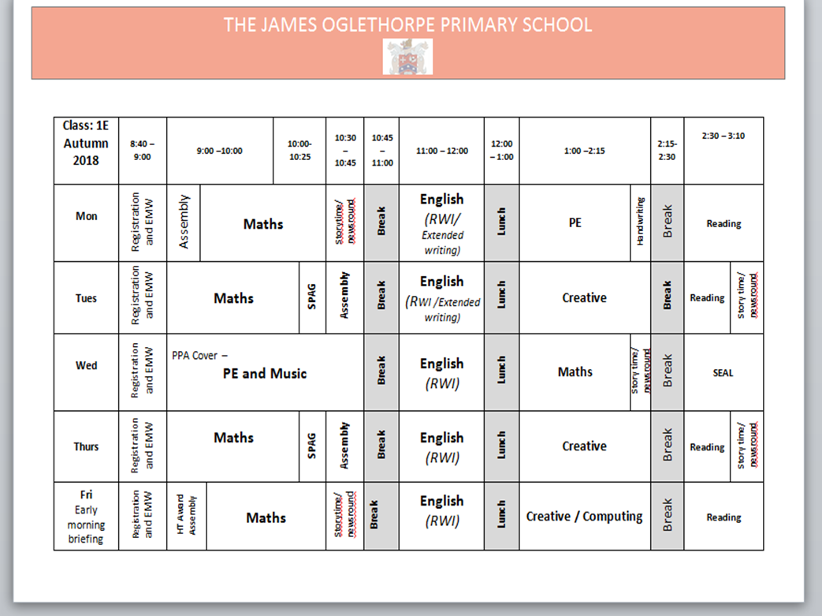
Typical Day
A

Slide 27
Trips/ WOW moments
A
Toys Workshop– 4th October
Toy story dress-up day.
Other trips TBC- based around children’s learning and topics

Slide 28
Important dates
All dates for the year will be put onto the calendar on the newlook website in the next few days.
Phonics Screening will be week commencing Monday 10th June 2018

Slide 29
Website and Social Media
Fortnightly newsletter 2 sides max
Photographs will be put onto website and social media
We will respect your wishes if you have signed against this on your GDPR form
Please share our Facebook posts and retweet to get more people to see what we do here
Reviews and positive comments on social media help to spread the work that we do

Slide 30
Advertising the school
Showcase Evening - 11th October 2018 5-7pm
Tours of the school - 6 during the Autumn term for new reception 2019
This term is vitally important to publicise our school for the new Reception 2019 cohort. Every child enrolled into the school brings in just under £3,000.
Currently we are just under 80 pupils short. If we were full to capacity we would have an additional £240,000 to spend on our children.
What could we do with that amount of money?

Slide 31
You can help to spread the word

Slide 32
The future is bright!

Slide 33
Last moan - Parking
Please be considerate when parking in the nearby streets.
Try not to block drives as any altercation unfortunately comes back on our school.

Slide 34
Thank you for your continuing support and we look forward to the year ahead
Any questions?

